Slide 1
Answers for Employers on COVID-19
March 27, 2020

Slide 2
Introduction

Slide 3
Today’s Agenda
Situation Summary
Latest Updates
Common Employer Questions

Slide 4
Situation Summary

Slide 5
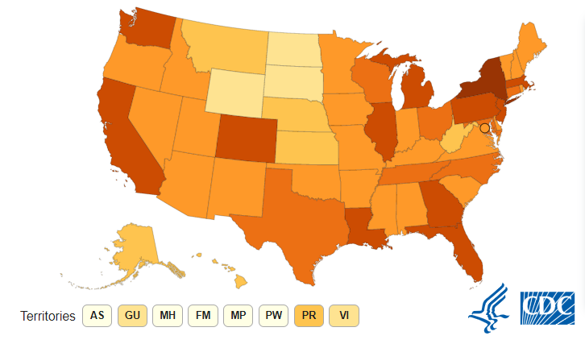
Situation Summary
Total Cases: 68,440
Total Deaths: 994
Jurisdictions: 54
All 50 states, DC, Puerto Rico, Guam, US Virgin Islands
27 states are reporting community spread

Slide 6
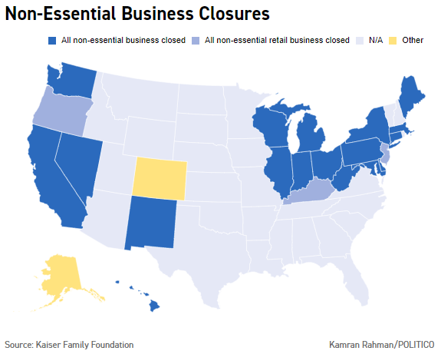
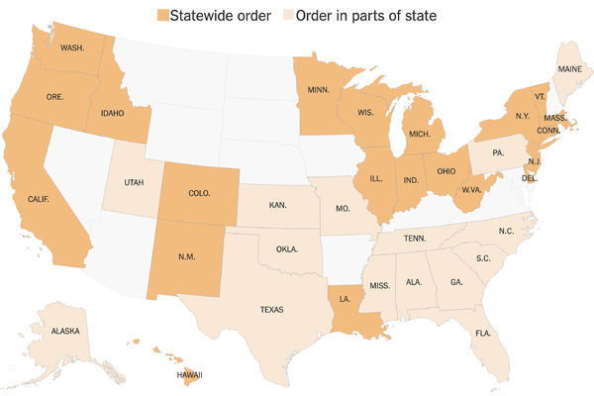
State Orders
“Stay-at-home” orders vary by state. Residents are typically instructed to stay at home unless going out for essential activities.
The definition of “non-essential” varies from state to state

Slide 7
CARES Act
Coronavirus Aid, Relief and Economic Security Act
Passed by Senate on March 25, expected to be voted on by House today
Major provisions
Stimulus checks to households
Business loan programs
Funding for unemployment insurance
Increased spending on hospitals
Health plan coverage

Slide 8
Latest Updates

Slide 9
DOL Guidance on FFCRA Paid Leave
DOL: paid leave rules take effect on April 1
The DOL is providing guidance on its website at https://www.dol.gov/agencies/whd/pandemic:
Fact Sheets for employers and employees
Questions and Answers on FFCRA, FLSA, FMLA, FFCRA notice
Posters on employee rights under expanded FMLA And Paid Sick Leave
Field Assistance Bulletin on temporary non-enforcement period
Regulations are expected in April

Slide 10
FFCRA Temporary Non-Enforcement Policy
Field Assistance Bulletin No. 2020-1
The DOL will not bring enforcement actions against any employer for violations of the Act occurring within 30 days of the enactment of the FFCRA (March 18 - April 17, 2020)
The employer must make reasonable, good faith efforts to comply with the Act

Slide 11
Is paid leave available for business closures or furloughs?
DOL: No, paid leave is not available in the following situations:
Worksite is closed due to lack of business or Federal, state or local directive (before or after April 1)
Worksite is closed while an EE is on paid leave (after date of closure)
EE is furloughed because there is not enough work or business
EEs hours are reduced because there is not enough work

Slide 12
FFCRA Poster Rules
Covered employers must post a FFCRA notice in a conspicuous place on their premises
An employer may email or direct mail the notice, or post it on an employee information internal or external website
Not required to be posted in multiple languages

Slide 13
IRS Guidance on Tax Credits
IR-2020-57: describes agency plan for tax credits for COVID-19 leave provided April 1- Dec. 31
Refundable payroll tax credits provide 100% reimbursement for the cost of providing COVID-19-related leave
Health insurance costs are also included in the credit – guidance needed
Employers face no payroll tax liability
Self-employed individuals receive an equivalent credit

Slide 14
Tax Credit Details
Eligible employers can retain payroll taxes equal to the amount of leave that they paid instead of depositing with IRS
Include withheld federal income taxes, the employee share of Social Security and Medicare taxes, and the employer share of Social Security and Medicare taxes with respect to all employees
If insufficient payroll taxes to cover the cost of leave paid, employers will be able file a request for an accelerated refund payment from the IRS

Slide 15
Tax Credit Examples
ER paid $5,000 in sick leave and would normally deposit $8,000 in payroll taxes (including taxes withheld from EEs)
ER can use $5,000 for leave payments and would only have to deposit $3,000 on its next regular deposit date
ER paid $10,000 in sick leave and would normally deposit $8,000 in taxes
ER could use the entire $8,000 for leave payments and file a request for an accelerated credit for the remaining $2,000
Equivalent amounts are available to self-employed individuals
Credits will be claimed on their income tax returns and will reduce estimated tax payments

Slide 16
IRS Delay on Tax Deadlines
The filing deadline for tax returns has been extended from April 15 to July 15
Delay applies to all taxpayers with a Federal income tax return or payment due on April 15, 2020
Includes individuals, trusts, estates, corporations and any type of unincorporated business entity
State delays are up to each state

Slide 17
Common Employer Questions

Slide 18
Can we require employees to stay home from work after travel?
Yes, employers may require employees to stay away from the worksite after traveling for a period of time
Employers should consider telework when possible
Ensure that requirements do not discriminate based on a protected class
This situation is not addressed in paid sick leave rules

Slide 19
What do we do if an employee is diagnosed with COVID-19?
Employees who appear to have symptoms (i.e., fever, cough, or shortness of breath) at work should be:
Immediately separated from other employees, customers, and visitors and
Sent home
If an employee is confirmed to have COVID-19 infection:
Employers should inform fellow employees of their possible exposure to COVID-19 in the workplace
Employers must maintain confidentiality as required by the Americans with Disabilities Act (ADA)
The fellow employees should self-monitor for symptoms

Slide 20
Which employers have to provide paid leave?
The paid sick leave and expanded FMLA rules apply to some public employers and to private employers with fewer than 500 employees
Health care providers and emergency responders can be exempt
Small businesses with fewer than 50 employees may qualify for exemption from the requirement to provide paid leave due to school or child care closings

Slide 21
What paid leave is required under the FFCRA?
Two weeks (up to 80 hours) of paid sick leave at the employee’s regular rate of pay (or minimum wage if higher)
Where the employee is:
Unable to work because the employee is quarantined or isolated (pursuant to Federal, State, or local government order or advice of a health care provider) and/or
Experiencing COVID-19 symptoms and seeking a medical diagnosis
Maximum: $511/day; $5,110 total

Slide 22
What paid leave is required under the FFCRA?
Two weeks (up to 80 hours) of paid sick leave at 2/3 the employee’s regular pay rate (or minimum wage if higher)
Because the employee is:
Unable to work because of a bona fide need to care for an individual subject to quarantine or isolation
Unable to work because of a bona fide need to care for a child (under 18 years of age) whose school or child care provider is closed or unavailable for reasons related to COVID-19, and/or
Experiencing similar condition specified by DOL/IRS/HHS
Maximum: $200/day; $2,000 total

Slide 23
What paid leave is required under the FFCRA?
Up to an additional 10 weeks of paid expanded FMLA leave at 2/3 the employee’s regular rate of pay (or minimum wage if higher)
The first 10 days of expanded FMLA leave are unpaid
Where an employee:
Has been employed for at least 30 calendar days and
Is unable to work due to a bona fide need for leave to care for a child whose school/child care provider is closed/unavailable for reasons related to COVID-19
Maximum: $200/day; $10,000 total ($12,000 when combined with paid sick leave for the same reason)

Slide 24
What if we provide paid leave before April 1 or pay more than required?
DOL:
Additional paid leave must be provided beginning April 1
Employers can’t deny paid sick leave if leave was already provided before April 1
Tax credits are not available for supplemental leave or pay
IRS:
Eligible employers will be able to claim tax credits based on qualifying leave they provide between the effective date and December 31, 2020 (not before)

Slide 25
How do you determine whether an employer has fewer than 500 EEs?
Use employee count at the time the leave is to be taken
Count full-time and part-time employees within the U.S. (including territories and possessions), including:
Employees on leave
Temporary employees who are jointly employed by you and another employer
Day laborers supplied by a temporary agency
Do not count independent contractors

Slide 26
Commonly Owned Companies
A company with separate establishments or divisions is considered to be a single employer
Commonly owned companies are separate employers unless they are joint employers under the FLSA with respect to certain employees
If two entities are joint employers, all of their common employees must be counted
Employer integration rules apply under the FMLA

Slide 27
FLSA Joint Employer Test
There are two potential scenarios where an employee may have one or more joint employers
Employee performs work for the employer that simultaneously benefits another individual or entity
Employers are sufficiently associated with respect to the employment of the employee
Joint employment is a facts and circumstances determination

Slide 28
FMLA Integrated Employer Test
All employees of the corporation, at all locations, are counted for FMLA purposes
Separate entities or corporations may be parts of a single employer for FMLA purposes if they meet the integrated employer test
Factors to be considered
Common management
Interrelation between operations
Centralized control of labor relations
Degree of common ownership or financial control

Slide 29
Will there be a law that helps employers with more than 500 EEs?
There are no current plans to require paid leave for employees of larger companies
These companies are more likely to provide paid leave already
Other COVID-19 legislative relief efforts may apply to large employers

Slide 30
How do small employers get an exemption from paid leave rules?
Exemptions are available to businesses with fewer than 50 employees
If providing leave would jeopardize the viability of the business as a going concern
Document why the business meets the criteria (will be addressed in more detail in forthcoming regulations)
Do not send any materials to the DOL

Slide 31
What are exempt medical providers/emergency responders?
This term is not defined in the statutory language or in any existing DOL guidance
Additional information is expected in DOL regulations
Employers should make good faith efforts to comply during the non-enforcement period

Slide 32
Do paid sick leave rules apply to part-time employees?
Yes, a part-time employee is entitled to:
Paid sick leave for normally scheduled work hours in a two-week period
Expanded FMLA leave for normal number of work hours per day up to 10 weeks
Determining hours if no normal schedule
Use a six-month average to calculate the average daily hours
If not employed for 6 months, use the number of hours agreed to upon hiring
If no agreement, use average hours/day scheduled over the term of employment

Slide 33
What records must an employer keep?
Employers must maintain appropriate documentation in support of the reason for the leave:
Employee name
Qualifying reason for requesting leave
Statement that the employee is unable to work (including telework) for that reason
Dates for which leave is requested
Documentation of the reason for the leave

Slide 34
What documentation can an employer require?
Examples of documentation of the reason for leave
A copy of any quarantine or isolation order
Written documentation from the health care provider that has advised self-quarantine
A notice that has been posted on a website, published in a newspaper or sent via email regarding school or daycare closure
Existing FMLA certification requirements apply for existing reasons for FMLA leave (such as a serious health condition)

Slide 35
Is the paid leave in addition to an employer’s existing leave policy?
Yes, the paid leave requirements are new entitlements beginning April 1
Employees must choose which leave to take, unless the employer agrees that they can be used concurrently
Employers can allow employees to supplement paid leave with existing employer leave or can provide additional pay
Employers cannot require employees to use paid leave and cannot claim a tax credit for additional amounts

Slide 36
How do the leave laws work together?
Employees may be eligible for both types of paid leave but only for a total of 12 weeks
Paid sick leave is intended to cover the unpaid first 10 days of expanded FMLA leave (if applicable)
Paid sick leave is limited to 80 hours (or max hours for PT EEs)
Employees do not get multiple periods of paid sick leave for multiple reasons

Slide 37
Can paid leave be taken intermittently?
Teleworking: Yes, if employer agrees (in any increment agreed to)
Working at usual worksite: No, if reason for leave is due to illness, quarantine/isolation or caring for a sick/quarantined/isolated person
Working at usual worksite: Yes if reason for leave is childcare and employer agrees (in full-day increments only for paid sick leave and possibly expanded FMLA)
DOL encourages collaboration to achieve flexibility

Slide 38
Must health coverage be maintained during paid leave?
Expanded FMLA: coverage must be maintained as if the employee had continued to work
Employee must make normal contribution
Coverage may end if employee does not return to work after FMLA leave
Paid sick leave: employer must continue health coverage under HIPAA due to restrictions on actively-at-work provisions

Slide 39
What if an employee has already used their FMLA leave for the year?
The FFCRA provides additional qualifying reasons for leave under the FMLA
It does not require additional FMLA leave beyond the aggregate 12 weeks of leave (or 26 weeks for military family leave)

Slide 40
What is the age limit for caring for a child (school/daycare closure)?
The expanded FMLA applies when employee has to care for a son or daughter under 18 years of age if the school or child care provider is closed or unavailable due to a COVID-19 public health emergency
The emergency paid sick leave language does not specify an age but DOL guidance indicates it is also under 18

Slide 41
What if an employer does not provide paid sick leave?
Covered employers that do not provide paid sick leave will be subject to FLSA penalties and enforcement
Employers that do not provide expanded FMLA leave are subject to the enforcement provisions of the FMLA
The DOL is providing a temporary non-enforcement period for 30 days if the employer has acted reasonably and in good faith

Slide 42
What is included in coverage for COVID-19 testing?
Group health plans and health insurance issuers must cover COVID-19 testing
No cost-sharing, preauthorization or medical management may apply
Covered items and services
Diagnostic products approved by FDA (and administration)
Items and services furnished during health care provider visits (including telehealth visits) that result in or relate to a test
CARES Act would expand covered items and services

Slide 43
How does waiving copays and cost-sharing affect HSA eligibility?
States and carriers are providing telehealth services with no cost-sharing
FFCRA does not address non-COVID-19 treatment or HSA eligibility
IRS guidance only addresses COVID-19 treatment
The CARES Act would provide flexibility for HSAs and allow other types of treatment before the deductible is met

Slide 44
What happens to health coverage for laid-off employees?
Eligibility terms of the plan will apply
Some states and carriers are providing flexibility for reduced hours
If coverage is terminated, COBRA or state continuation will apply
Some states are requiring additional open enrollment periods for individual coverage and Exchanges

Slide 45
How is the look-back measurement method affected by leave or layoff?
“Hours of service” must be counted during measurement period
Time an employee is paid for time working or not working
Special rules for periods of unpaid FMLA
Full-time employees who are in a stability period must continue to be treated as full-time as long as they are employed

Slide 46
How can employers comply with WARN Act rules?
Employers with 100+ employees must provide at least 60 days’ notice for layoffs/terminations of 50+ employees at single site of employment
Exception applies for “unforeseeable circumstances”
Some states have been easing requirements for COVID-19
Unforeseeable Circumstances Exemption
As much advance notice as possible
Must be caused by sudden, dramatic and unexpected action or condition
Outside of employer control
Examples
Unanticipated and dramatic economic downturn
Government-ordered closures without notice

Slide 47
Questions?

Slide 48
Thank You!
This presentation is current as of the date presented and is for informational purposes only. It is not intended to be exhaustive nor should any discussion or opinions be construed as legal advice. Please contact legal counsel for legal advice on specific situations. This presentation may not be duplicated or redistributed without permission. © 2020 Zywave, Inc. All rights reserved.

